Slide 1
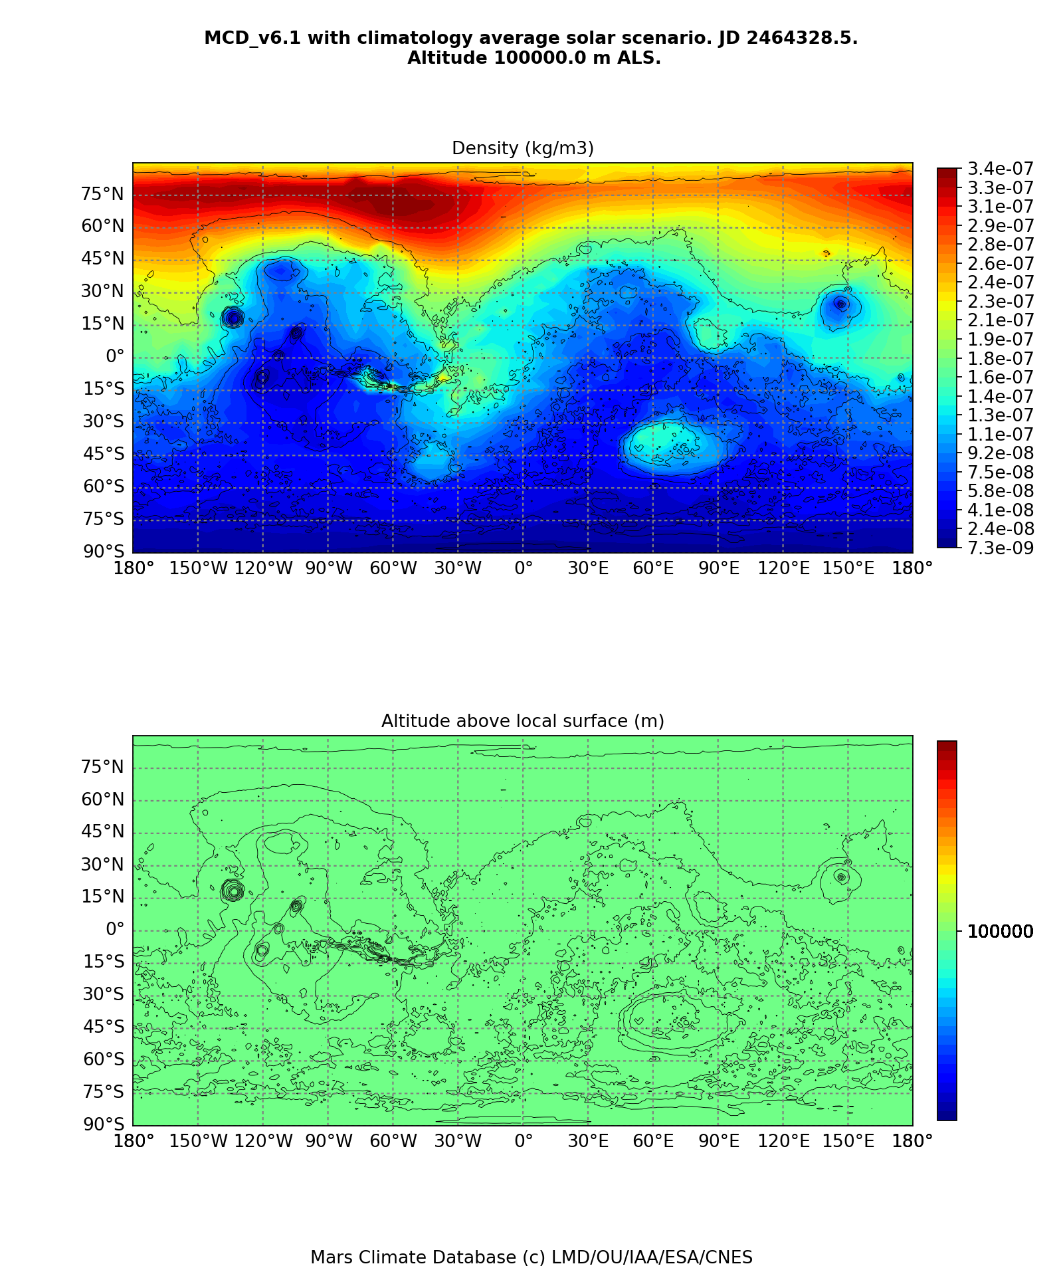
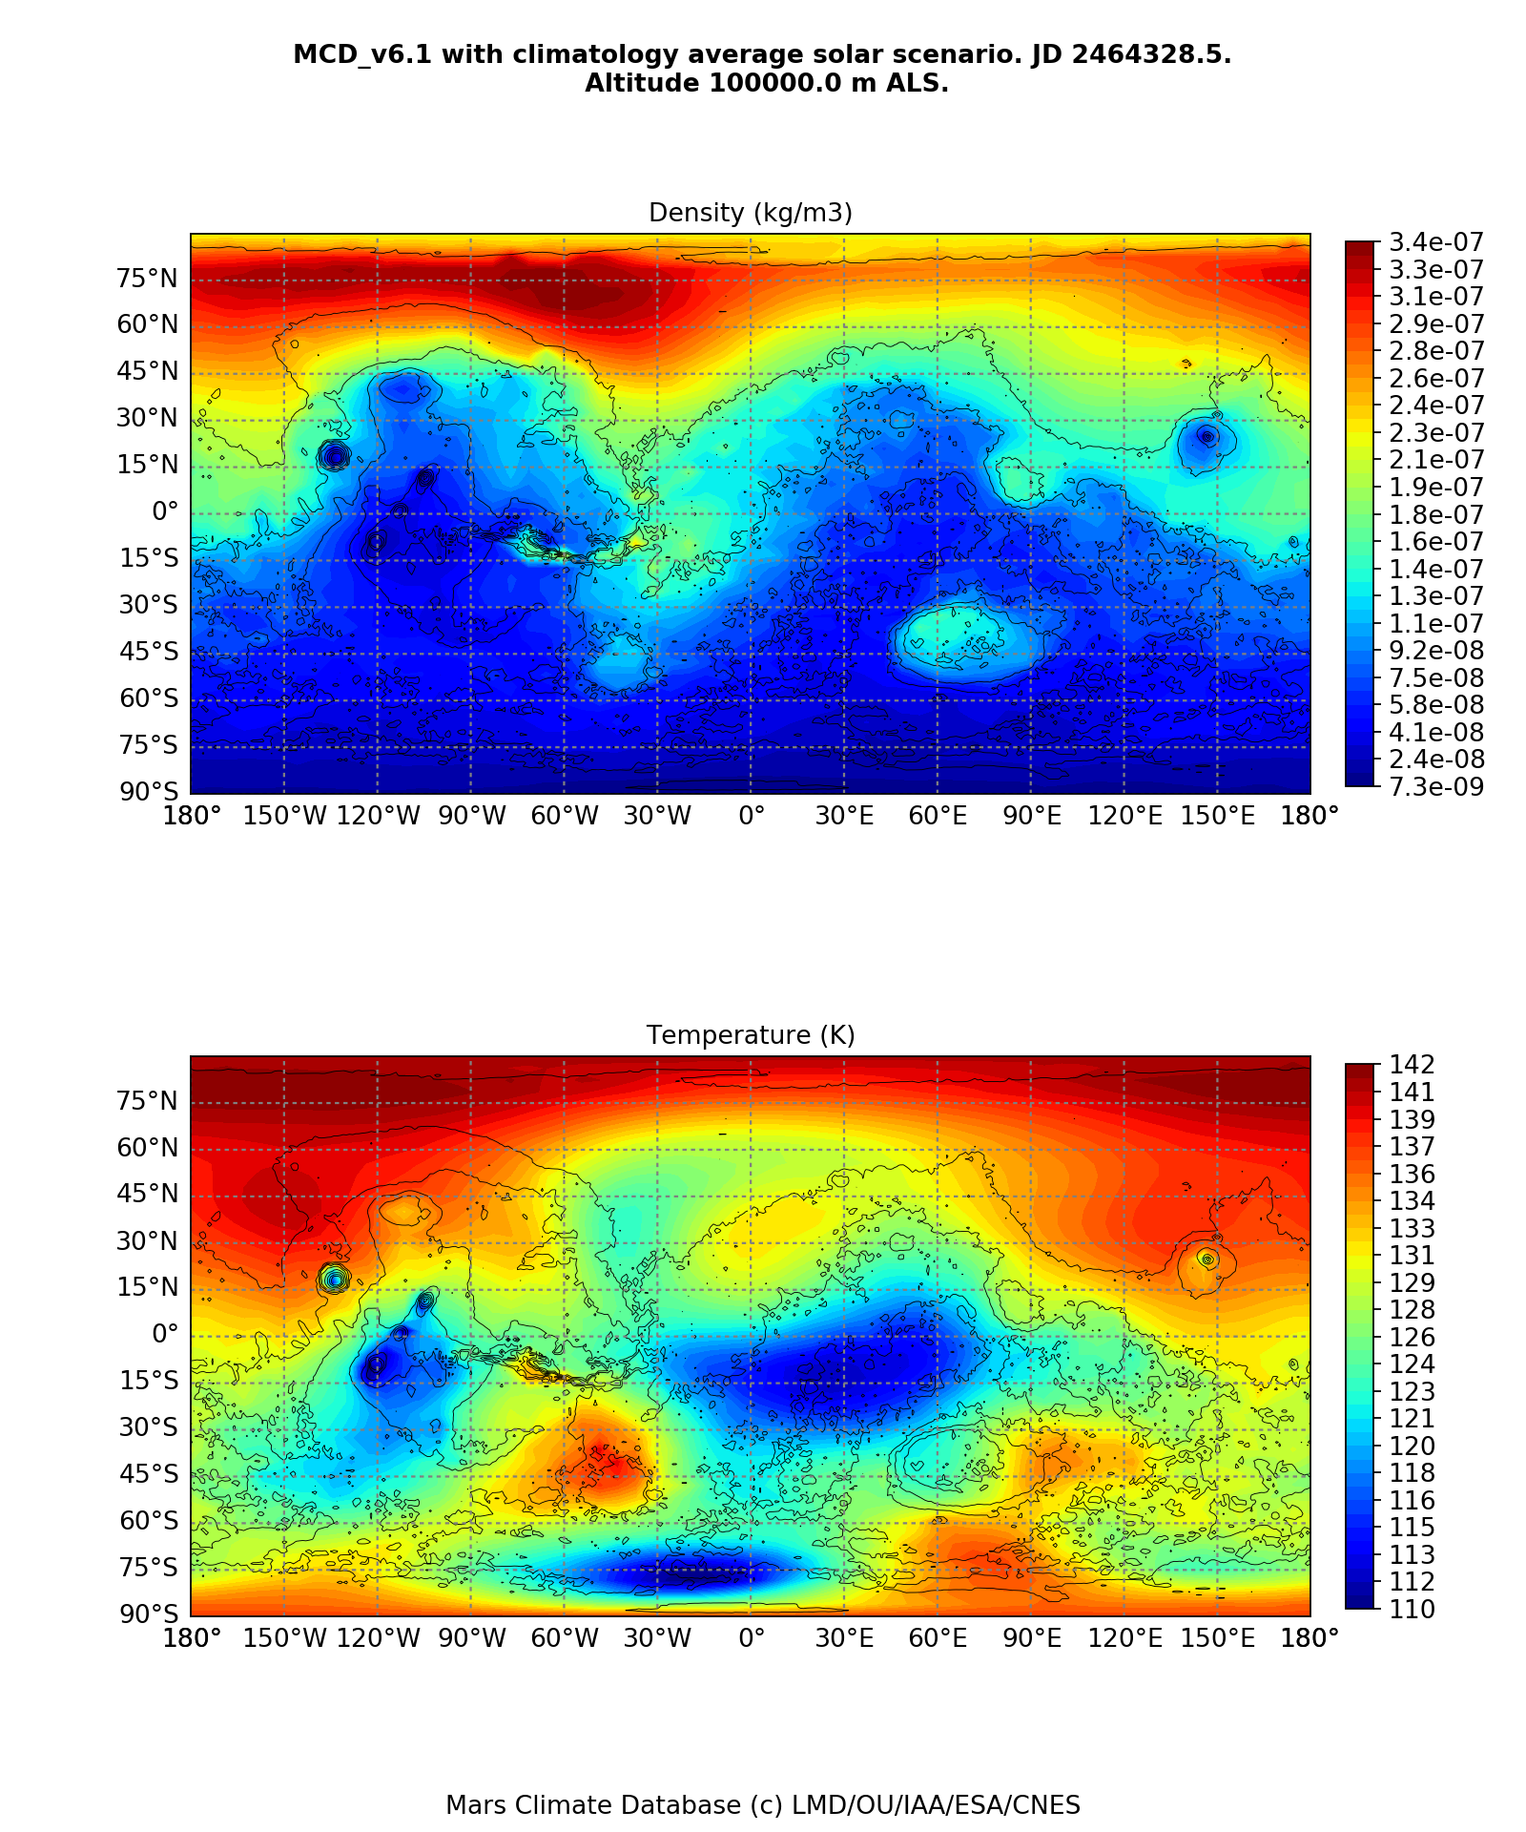
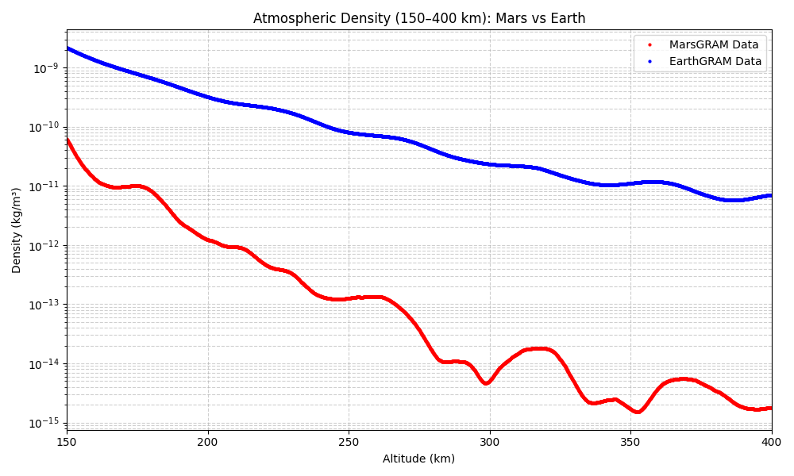
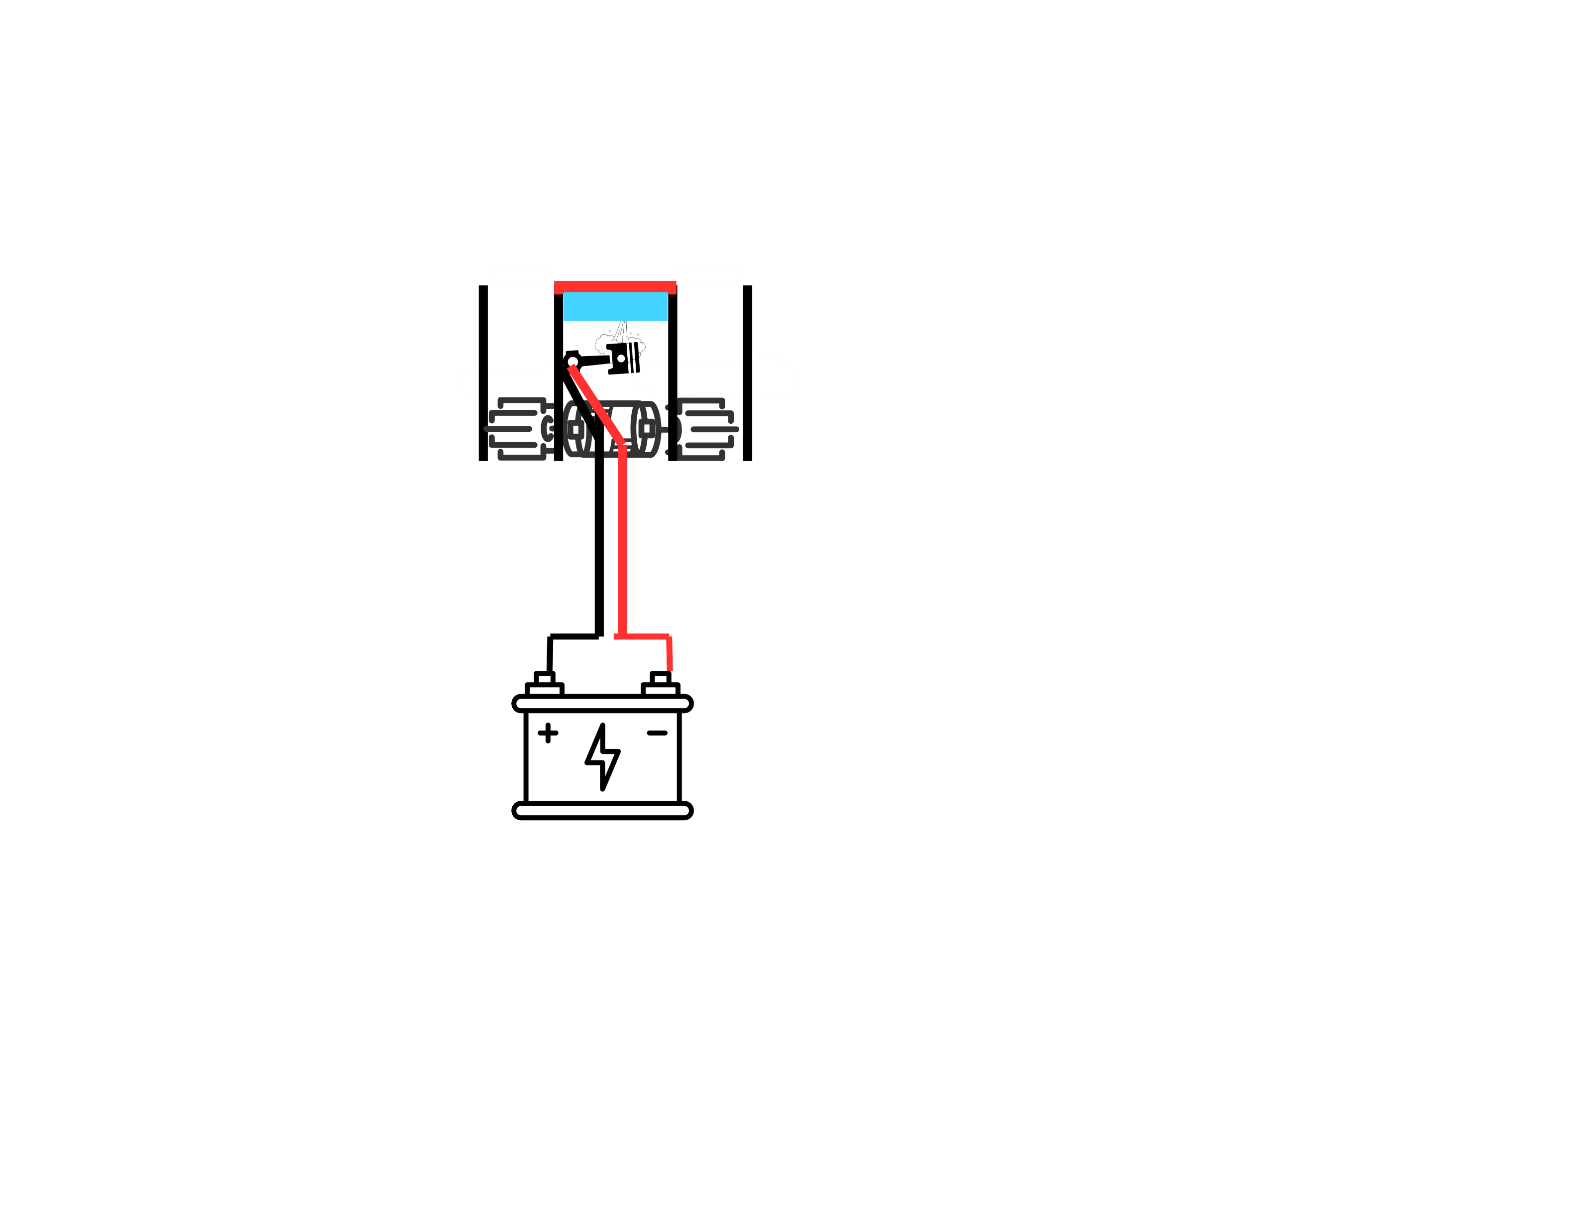
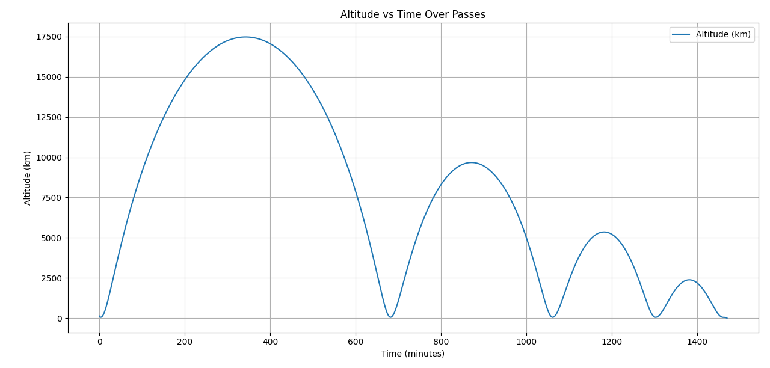
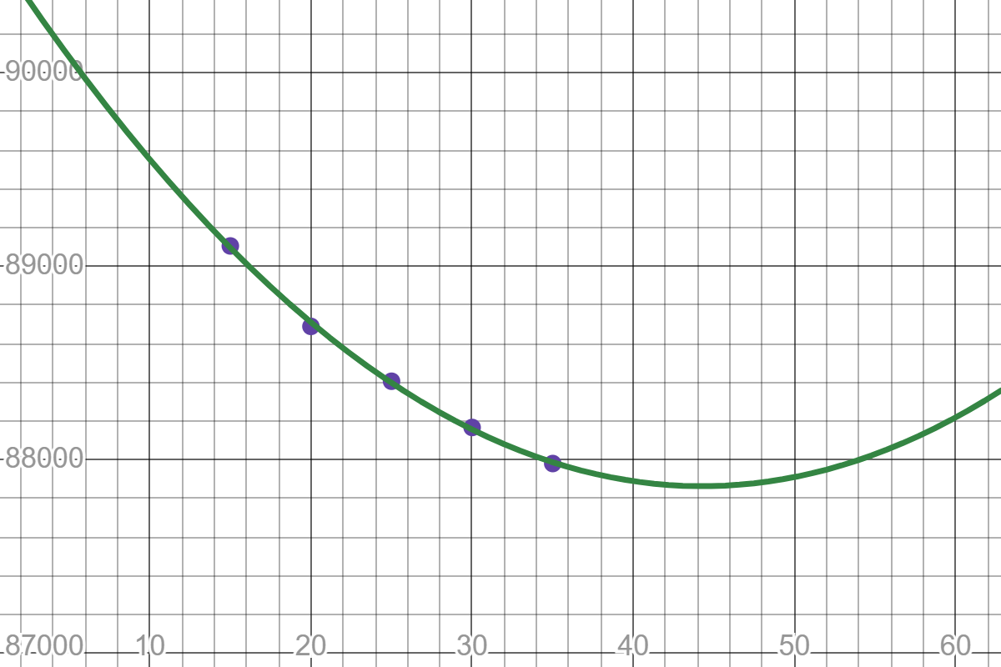
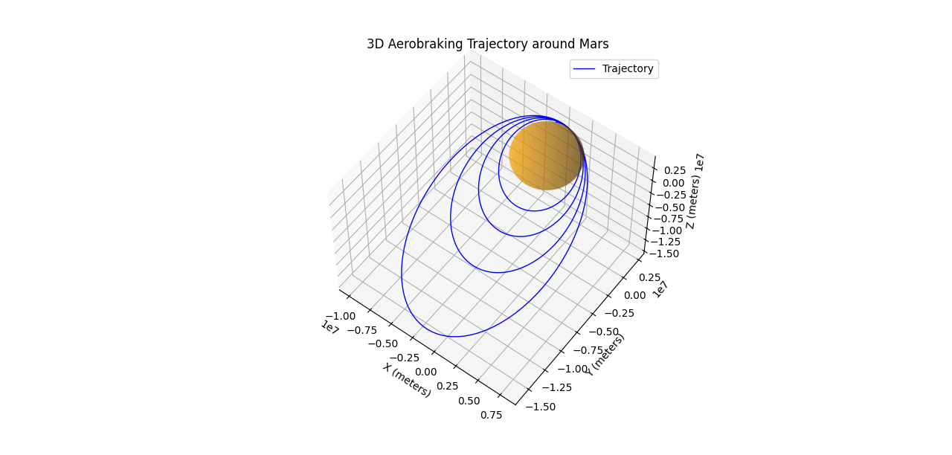
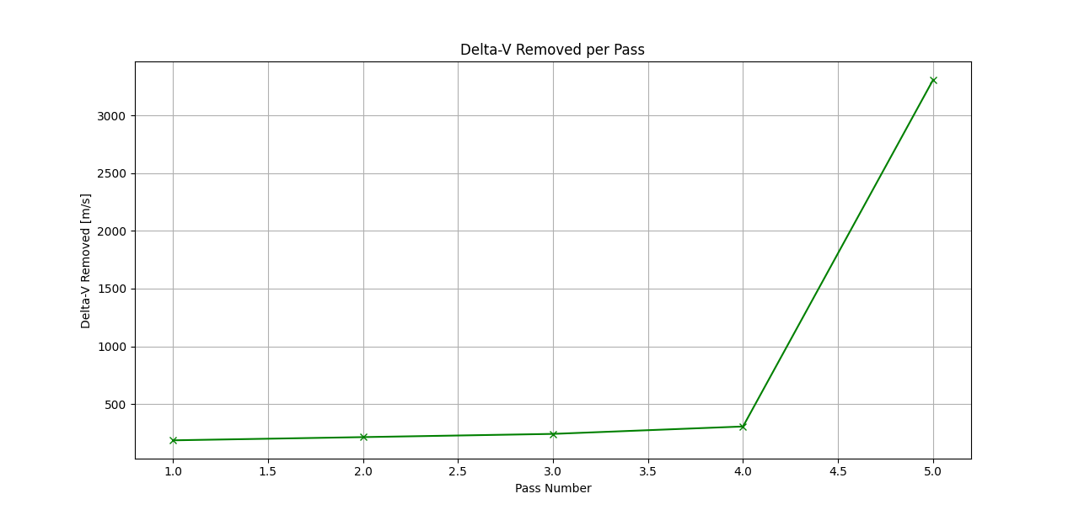
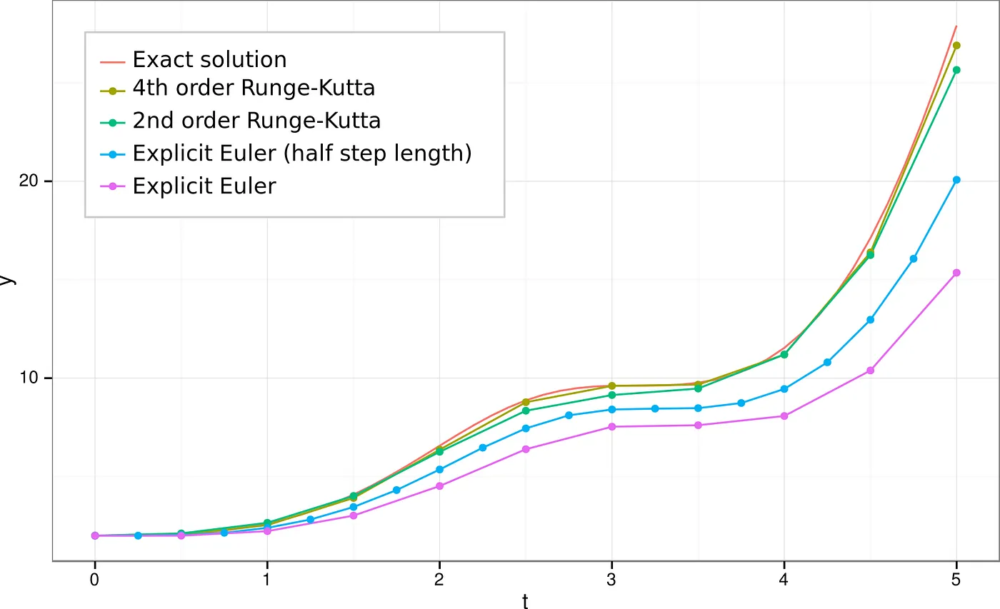
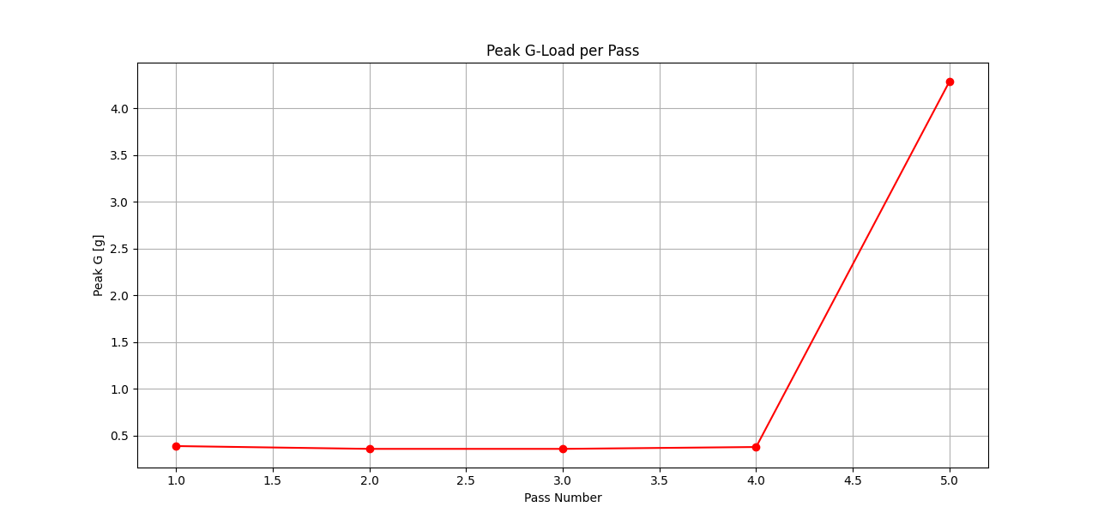
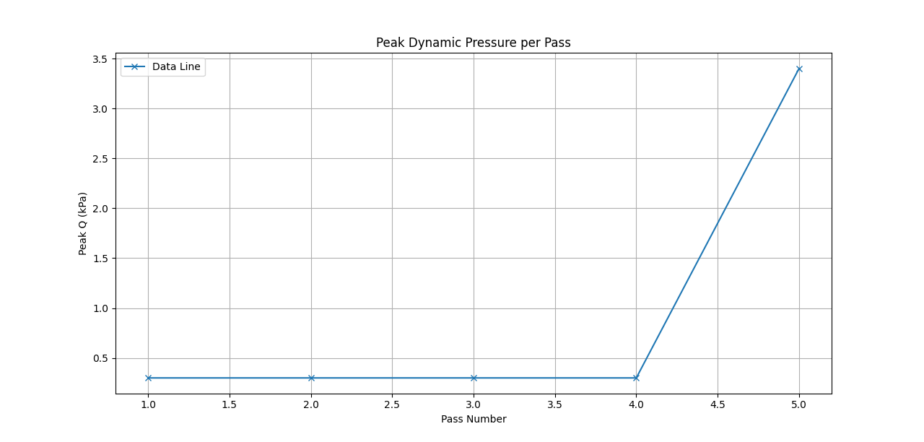

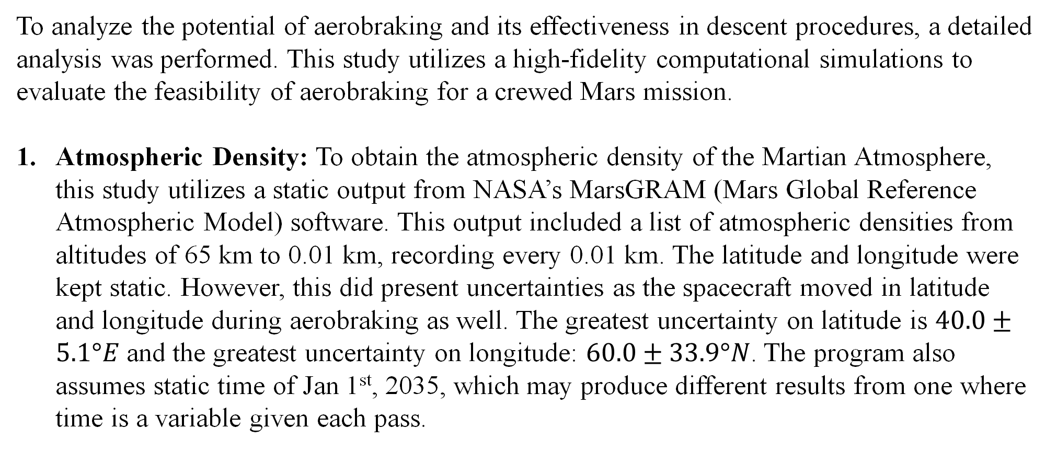
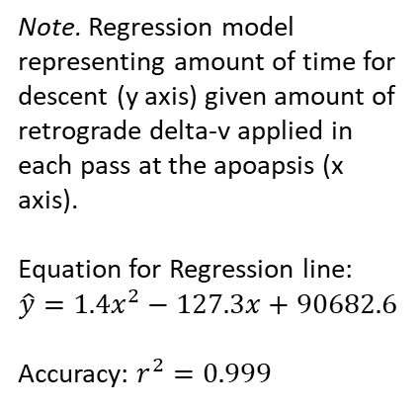
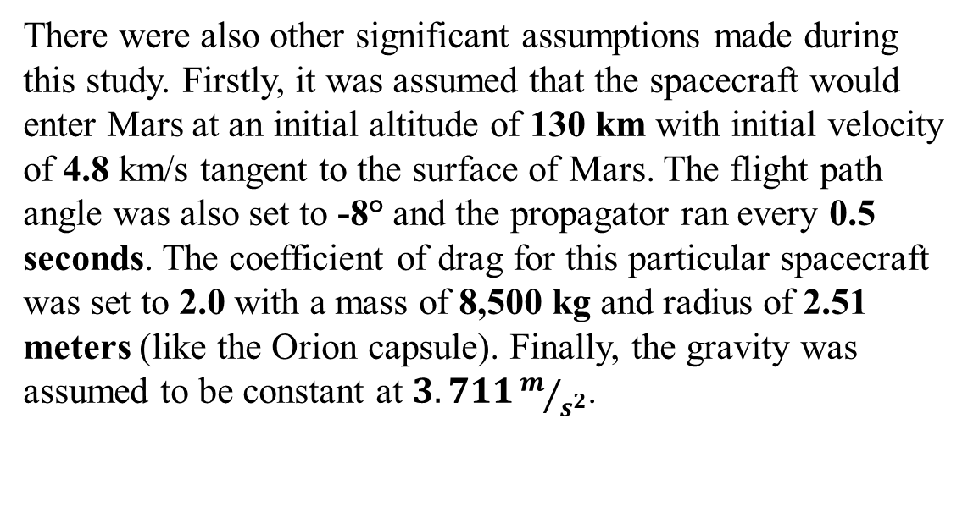
Feasibility of Crewed Mars Mission Landing with Aerobraking
Dr. Lynnane George, Aryan Tuteja
ªDepartment of Mechanical and Aerospace Engineering, University of Colorado Colorado Springs
INTRODUCTION/MOTIVATION
ASSUMPTIONS/DECISIONS
CONCLUSIONS & FUTURE WORK
Crewed Martian exploration has long remained an ambitious dream of mankind. However, many factors including vast distances, need for technological advancements, and challenges of long-duration space flight have hindered many efforts. This research aims to relieve one of those issues by exploring how aerobraking can be used in conjunction to other methods for safer, quicker, and more efficient descent onto the Red Planet.
Traditionally, spacecraft have relied on EDL (Entry, Descent, Land) procedures which involves hypersonic entry, aerodynamic braking during aerocapture, and supersonic retro propulsion for landing. This method is often more extreme and can lead to many problems such as unsustainable g-loads and higher dynamic pressure.
Gravitational Load:
When entering the Martian atmosphere, many non-crewed missions experience immense force due to continuous acceleration required in a negligible atmosphere. For example, the Curiosity rover experienced up to 13 g of force (Lee et al., 2024, p. 1) while Perseverance handled 10 g of gravitational load during descent (Harwood, 2021, p. 1). While these values may be acceptable for machinery, they are simply intolerable for human missions, which are restricted to a 5 g limit since human intervention may be necessary during descent.
Dynamic Pressure:
Dynamic Pressure (often measuring in kPa) is the amount of pressure the spacecraft experiences by the atmosphere due to its velocity. This pressure can often cause heating and create unsafe conditions for the spacecraft. For example, Curiosity experienced 14.87 kPa of dynamic pressure (Karlgaard et al., 2021), creating 3,800 degrees Fahrenheit of heat in the process (Way, Davis, & Shidner, 2013). Limiting these values will ensure more sustainable heat and lower fuel usage.
This section explores some of the results of the aerobraking simulations.
Overall, it was found that aerobraking significantly reduces the peak–g and dynamic pressure values. This technology also has the potential to significantly reduce the delta-v by 752.16 m/s with just three passes, thereby saving the scarce fuel supply for a crewed mission to Mars.
There are some limitation that can be improved upon, however. Most prominently, several variables (including atmospheric drag and acceleration due to gravity) in this study were kept static, though they would be variable. Some other variables (such as initial altitude, flight path angle, and initial velocity) were mere assumptions, and running a systems tool kit (STK) would lead to more realistic numbers.
This mission is also an extension of a bigger goal that aims to take a crewed mission from Earth to Mars to Ceres. Further analyzing how it would fit into the overall mission would help in providing more realistic numbers and understanding how much retrograde delta-v can be realistically applied to speed up amount of time it takes for the astronauts in land.
There are other future work that can be done by focusing solely on this mission. Particularly, it remains to be seen if a spacecraft with current technology (namely Orion) can support multiple passes through an atmosphere without experiencing any fatal disfunctions. This could include repetitive fluctuations in temperature, pressure, and recurring interactions with composites in the atmosphere.
Firstly, to obtain the ideal place for landing, this study identified both temperature and density of the Martian atmosphere at 100 km. The ideal location (selected to be 40°E and 60°N) included:
Close to the equator for lower pressure and uncertainty
Higher densities for efficient aerobraking
Plane area for accessible landing
Also, to understand how much different and more variable the atmosphere of Mars is compared to Earth, the data from MarsGRAM was compiled and visualized in the figure below.
Notes. Figure showing the temperature and density of Mars at an altitude of 100 km from surface on Jan 1st, 2035 (Midnight UTC). Recorded by querying Mars Climate Database on September 7th, 2025.
There were also other significant assumptions made during this study. Firstly, it was assumed that the spacecraft would enter Mars at an initial altitude of 130 km with initial velocity of 4.8 km/s tangent to the surface of Mars. The flight path angle was also set to -8° and the propagator ran every 0.5 seconds. The coefficient of drag for this particular spacecraft was set to 2.0 with a mass of 8,500 kg and radius of 2.51 meters (like the Orion capsule). Finally, the gravity was assumed to be constant at $3.711m/{s^{2}}$.
An interesting direction that future works could examine is how this atmospheric drag could be harnessed to create chemical energy from kinetic and further support life support systems on board. A simple prototype was created and could further be improved up as well. This prototype (present of the right) utilizes a turbine and thermal style generators to create energy from air particles (like an airborne windmill).
Notes. Comparison the density of Martian and Earth’s atmosphere
KEY RESULTS
EXPERIMENTAL/COMPUTATIONAL METHODS
The following graphs represent results of the simulation. The figures on the right and below show the trajectory while other graphs represent different factors during each pass.
The time for this spacecraft was also dependent on amount of retro delta-v applied. For delta v of:
0 m/s: 1504.14 mins
10 m/s: 1492.55 mins
20 m/s: 1478.15 mins
30 m/s: 1469.27 mins
In conclusion, this research was successfully able to support and promote the integration of aerobraking into current descent procedures to enhance safety, efficiency, and promote quicker landing than many other descent procedures. Special thanks to Dr. Lynnane George and other UCCS students for helping me throughout the process.
To analyze the potential of aerobraking and its effectiveness in descent procedures, a detailed analysis was performed. This study utilizes a high-fidelity computational simulations to evaluate the feasibility of aerobraking for a crewed Mars mission.
Atmospheric Density: To obtain the atmospheric density of the Martian Atmosphere, this study utilizes a static output from NASA’s MarsGRAM (Mars Global Reference Atmospheric Model) software. This output included a list of atmospheric densities from altitudes of 65 km to 0.01 km, recording every 0.01 km. The latitude and longitude were kept static. However, this did present uncertainties as the spacecraft moved in latitude and longitude during aerobraking as well. The greatest uncertainty on latitude is $40.0±5.1°E$ and the greatest uncertainty on longitude: $60.0±33.9°N$. The program also assumes static time of Jan 1st, 2035, which may produce different results from one where time is a variable given each pass.
REFERENCES
Note. Diagram highlighting the altitude of spacecraft above surface, given time in minutes. Each parabolic motion represents one pass around Mars.
Charles R. Harris, K. Jarrod Millman, Stéfan J. van der Walt, Ralf Gommers, Pauli Virtanen, David Cournapeau, Eric Wieser, Julian Taylor, Sebastian Berg, Nathaniel J. Smith, Robert Kern, Matti Picus, Stephan Hoyer, Marten H. van Kerkwĳk, Matthew Brett, Allan Haldane, Jaime Fernández del Río, Mark Wiebe, Pearu Peterson, Pierre Gerard-Marchant, Kevin Sheppard, Tyler Reddy, Warren Weckesser, Hameer Abbasi, Christoph Gohlke, & Travis E. Oliphant (2020). Array programming with NumPy. Nature, 585(7825), 357–362.
Harwood, W. (2021, February 19). Mars landing: NASA celebrates as Perseverance rover lands successfully - CBS News. https://www.cbsnews.com/news/mars-landing-nasa-perseverance-rover-touchdown/
Hunter, J. D. (2007). Matplotlib: A 2d graphics environment. Computing in Science & Engineering, 9(3), 90–95. https://doi.org/10.1109/MCSE.2007.55
Mars climate database v6. 1: The web interface. (n.d.). Retrieved September 6, 2025, from https://www-mars.lmd.jussieu.fr/mcd_python/
Justh , H. L., Cianciolo, A. M. D., & Hoffman, J. (2021). Mars Global Reference Atmospheric Model (Mars-GRAM): User Guide . National Aeronautical and Space Administration. https://ntrs.nasa.gov/api/citations/20210023957/downloads/Mars-GRAM%20User%20Guide.pdf
Karlgaard, C. D., Schoenenberger, M., Dutta, S., & Way, D. W. (2021). Mars Entry, Descent, and Landing Instrumentation 2 Trajectory, Aerodynamics, and Atmosphere Reconstruction. NASA Technical Reports Server. https://ntrs.nasa.gov/api/citations/20210024320/downloads/MEADSreconstruction.pdf
Lee, Y., Lee, D. Y., & Wie, B. (2024). A comparative study of entry guidance for Mars robotic and human landing missions. Acta Astronautica, 215, 178–193. https://doi.org/10.1016/j.actaastro.2023.11.045
Lyne, J. E. (1993). Effect of parking orbit period on aerocapture for manned Mars missions. Journal of Spacecraft and Rockets, 30(4), 484–487. https://doi.org/10.2514/3.25554
Mars global reference atmospheric model 2010 (Mars GRAM 2010)(MFS-33158-1) | nasa software catalog. (n.d.). Retrieved September 6, 2025, from https://software.nasa.gov/software/MFS-33158-1
OpenAI. (2025). ChatGPT (Mar 14 version) [Large language model]. https://chat.openai.com/chat. Used primarily for understanding concepts and debugging.
Pandas Development Team. (2025). Pandas-dev/pandas: Pandas (Version v2.3.2) [Computer software]. Zenodo. https://doi.org/10.5281/zenodo.16918803
Pauli Virtanen, Ralf Gommers, Travis E. Oliphant, Matt Haberland, Tyler Reddy, David Cournapeau, Evgeni Burovski, Pearu Peterson, Warren Weckesser, Jonathan Bright, Stéfan J. van der Walt, Matthew Brett, Joshua Wilson, K. Jarrod Millman, Nikolay Mayorov, Andrew R. J. Nelson, Eric Jones, Robert Kern, Eric Larson, CJ Carey, İlhan Polat, Yu Feng, Eric W. Moore, Jake VanderPlas, Denis Laxalde, Josef Perktold, Robert Cimrman, Ian Henriksen, E.A. Quintero, Charles R Harris, Anne M. Archibald, Antônio H. Ribeiro, Fabian Pedregosa, Paul van Mulbregt, and SciPy 1.0 Contributors. (2020) SciPy 1.0: Fundamental Algorithms for Scientific Computing in Python. Nature Methods, 17(3), 261-272. DOI: 10.1038/s41592-019-0686-2.
Van Rossum, G., & Drake, F. L. (2009). Python 3 Reference Manual. Scotts Valley, CA: CreateSpace
VisCircuit. (2024, May 31). Euler vs Runge-Kutta methods. Medium. https://medium.com/@viscircuit/euler-vs-runge-kutta-methods-de34565bf0cf
Way, D. W., Davis, J. L., & Shidner, J. D. (2013). Assessment of the Mars Science Laboratory Entry, Descent, and Landing simulation (NASA/TP-2013-216680). NASA Langley Research Center.
Note. Regression model representing amount of time for descent (y axis) given amount of retrograde delta-v applied in each pass at the apoapsis (x axis).
Equation for Regression line:
$$\hat{y}=1.4x^{2}−127.3x+90682.6$$
Accuracy: $r^{2}=0.999$
Acceleration due to Drag: To discern and apply the effects of drag on acceleration, velocity and position of the spacecraft, this study differentiated state vectors (position and velocity) with time to get rates of change for the state vectors. It also applies drag after differentiating velocity (giving acceleration) to account for those differences. Most prominently, this study the 4th order Runge Kutta differentiation method rather than Euler’s method for increased accuracy.
Note. 3D diagram showing the trajectory of the spacecraft around Mars.
Note. 3D diagram showing the trajectory of the spacecraft around Mars.
Note. Comparative Analysis of Euler and Runge-Kutta propagation methods. Initially published by VisCircuit on the Medium on May 31st, 2024.
Multi–Pass Simulation: This simulation executes multiple passes where each pass reduces the total velocity of the spacecraft. After each pass, the state vectors of the spacecraft are recorded, and an optional retrograde velocity is applied at the apoapsis. Peak-g, dynamic pressure, and delta–v values are recorded and analyzed at the end of the simulation.
Note. Graph representing the peak – g loads per pass.
Note. Graph representing the peak dynamic pressure per pass.

